Slide 1

CSE- 321
Software Engineering
Lecture : 08 Project Management
Fahad Ahmed
Lecturer, Dept. of CSE
E-mail: fahadahmed@uap-bd.edu

Slide 2
Lecture Outlines
Software project management
The 4 P’s
Management activities
Project planning
Risk management

Slide 3
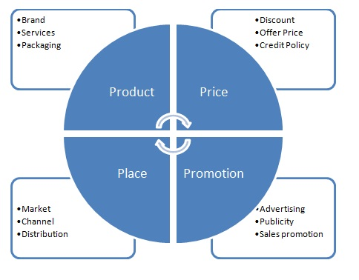
4Ps in Marketing

Slide 4
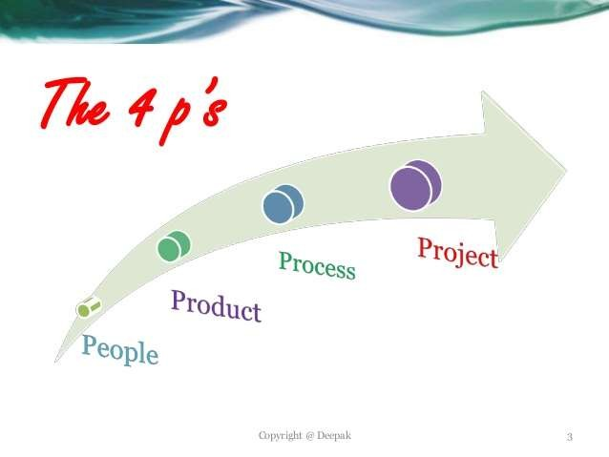
Software Project Management : The 4 P’s
People — the most important element of a successful project :Developers, project managers, testers, ..etc.
Product — the software to be built
Process — the set of framework activities and software engineering tasks required to get the job done.
Project — all work required to make the product a reality

Slide 5
Software Project Management : The 4 P’s
People — People of a project includes from manager to developer, from customer to end user. But mainly people of a project highlight the developers. It is so important to have highly skilled and motivated developers that the Software Engineering Institute has developed a People Management Capability Maturity Model (PM-CMM).
Product — Product is any software that has to be developed. To develop successfully, product objectives and scope should be established, alternative solutions should be considered, and technical and management constraints should be identified. Without this information, it is impossible to define reasonable and accurate estimates of the cost, an effective assessment of risk, a realistic breakdown of project tasks or a manageable project schedule that provides a meaningful indication of progress.

Slide 6
Software Project Management : The 4 P’s
Process — A software process provides the framework from which a comprehensive plan for software development can be established. A number of different tasks sets— tasks, milestones, work products, and quality assurance points— enable the framework activities to be adapted to the characteristics of the software project and the requirements of the project team.
Project —The project includes all and everything of the total development process and to avoid project failure. Here, the project manager has to do some job.

Slide 7
Software Project Management
Software Project Management
Concerned with activities involved in ensuring that software is delivered on time and on schedule and in accordance with the requirements of the organisations developing and procuring the software.
Project management is needed because software development is always subject to budget and schedule constraints that are set by the organisation developing the software.

Slide 8
Software Project Management
Management activities
Proposal writing.
Project planning and scheduling.
Project costing.
Project monitoring and reviews.
Personnel selection and evaluation.
Report writing and presentations.

Slide 9
Project planning
Probably the most time-consuming project management activity.
Continuous activity from initial concept through to system delivery. Plans must be regularly revised as new information becomes available.
Various different types of plan may be developed to support the main software project plan that is concerned with schedule and budget.

Slide 10
Project plan structure
Most plans should include the following sections:
Introduction.
Project organisation.
Risk analysis.
Hardware and software resource requirements.
Work breakdown.
Project schedule.
Monitoring and reporting mechanisms.

Slide 11
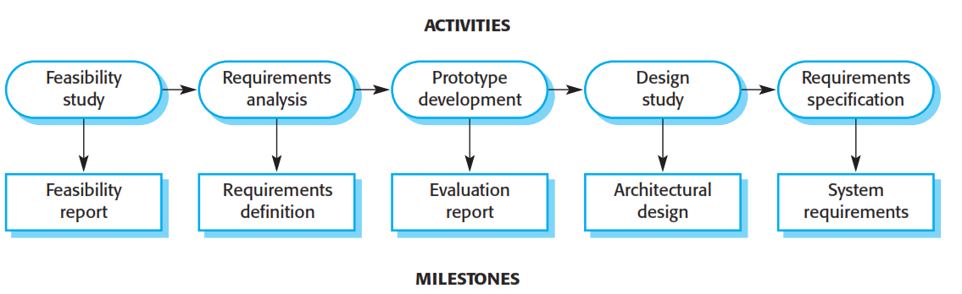
Milestones and Deliverables
Milestones are the end-point of a process activity.
Deliverables are project results delivered to customers.

Slide 12
Bar charts and activity networks
Graphical notations used to illustrate the project schedule.
Show project breakdown into tasks. Tasks should not be too small. They should take about a week or two.
Activity charts show task dependencies and the critical path.
Bar charts show schedule against calendar time.

Slide 13
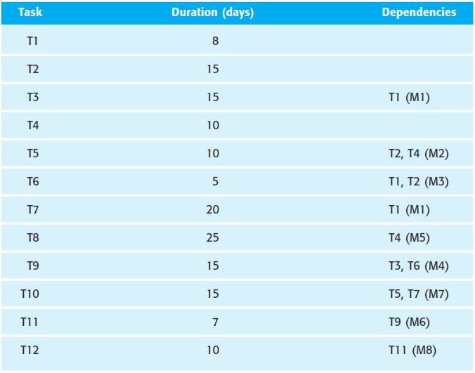
Task durations and dependencies

Slide 14
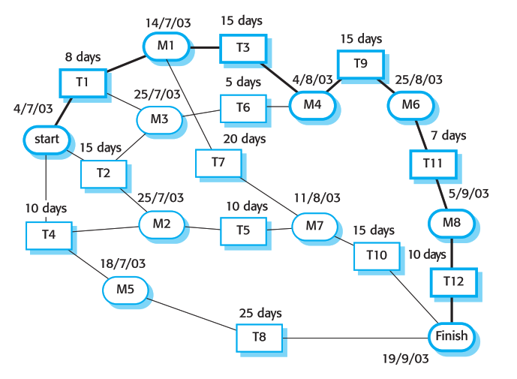
Activity network

Slide 15
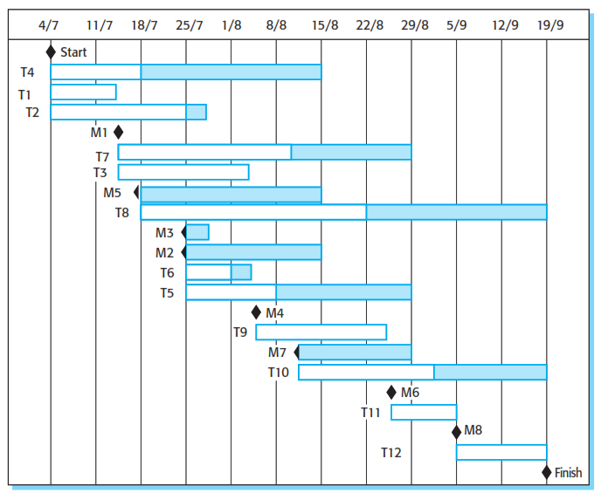
Activity timeline

Slide 16
Risk management
Risk management is concerned with identifying risks and drawing up plans to minimise their effect on a project.
A risk is a probability that some adverse circumstance will occur
Project risks affect schedule or resources;
Product risks affect the quality or performance of the software being developed;
Business risks affect the organisation developing or procuring the software.

Slide 17
Software risks

Slide 18
The risk management process
Risk identification
Identify project, product and business risks;
Risk analysis
Assess the likelihood and consequences of these risks;
Risk planning
Draw up plans to avoid or minimise the effects of the risk;
Risk monitoring
Monitor the risks throughout the project;

Slide 19
The risk management process
Risk identification
There are at least six types of risk that can arise:
Technology risks : Risks that derive from the software or hardware technologies that are used to develop the system.
People risks: Risks that are associated with the people in the development team.
Organisational risks: Risks that derive from the organisational environment where the software is being developed.
Tools risks: Risks that derive from the CASE tools and other support software used to develop the system.
Requirements risks: Risks that derive from changes to the customer requirements and the process of managing the requirements change.
Estimation risks: Risks that derive from the management estimates of the system characteristics and the resources required to build the system.

Slide 20
The risk management process
Risk analysis
During the risk analysis process, we have to consider each identified risk and make
a judgement about the probability and the seriousness of it. There is no easy way
to do this—we must rely on your own judgement and experience, which is why
experienced project managers are generally the best people to help with risk management.
These risk estimates should not generally be precise numeric assessments. But should be based around a number of bands:
• The probability of the risk might be assessed as very low (<10%), low
(10–25%), moderate (25-50%), high (50–75%) or very high (>75%).
• The effects of the risk might be assessed as catastrophic, serious, tolerable or
insignificant.

Slide 21
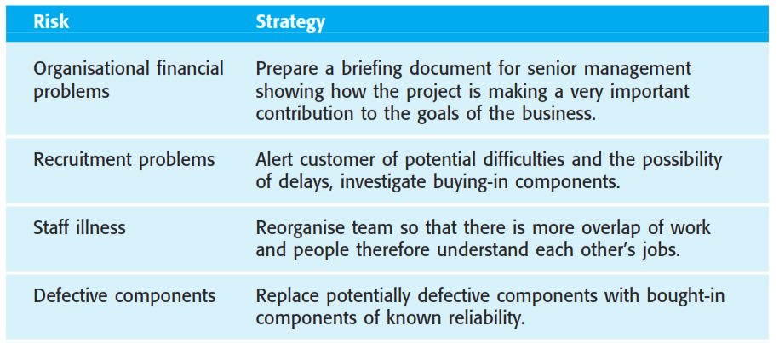
The risk management process
Risk Management strategies

Slide 22
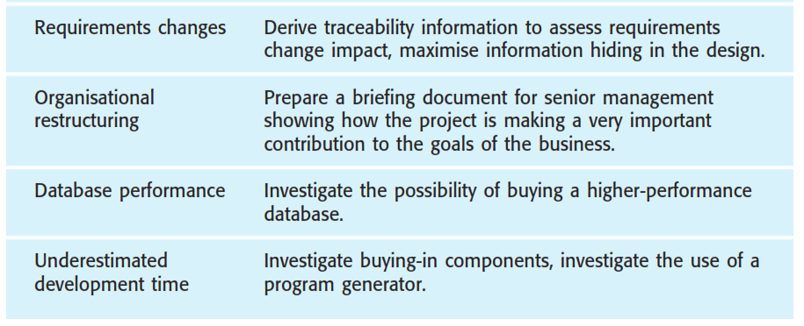
The risk management process
Risk Management strategies

Slide 23

Thanks to All

